Slide 1

Genetic Algorithm for Scheduling Optimization
Machine Learning Project

Slide 2
Objective
The goal is to optimize exam scheduling while satisfying room capacity, type compatibility, and logistical constraints.
Leverage Genetic Algorithms to find efficient and conflict-free schedules and make the best schedule automatically

Slide 3
What is a Genetic Algorithm?
It’s a method that computers use to solve problems by imitating how living things evolve and improve over time.
Start with random solutions (like guessing).
Choose the best ones and improve them.
Keep improving until we find the best solution!

Slide 4
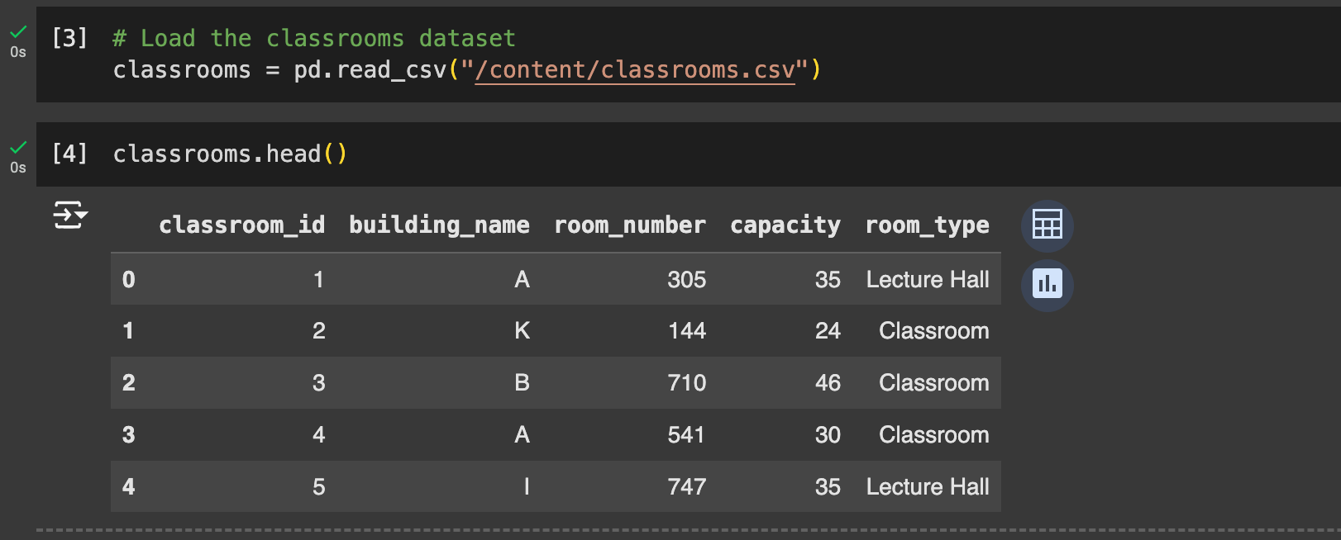
Dataset Overview
Total Rows: 30
Columns: classroom_id, building_name, room_number, capacity, room_type
Distribution of room types and capacity.

Slide 5
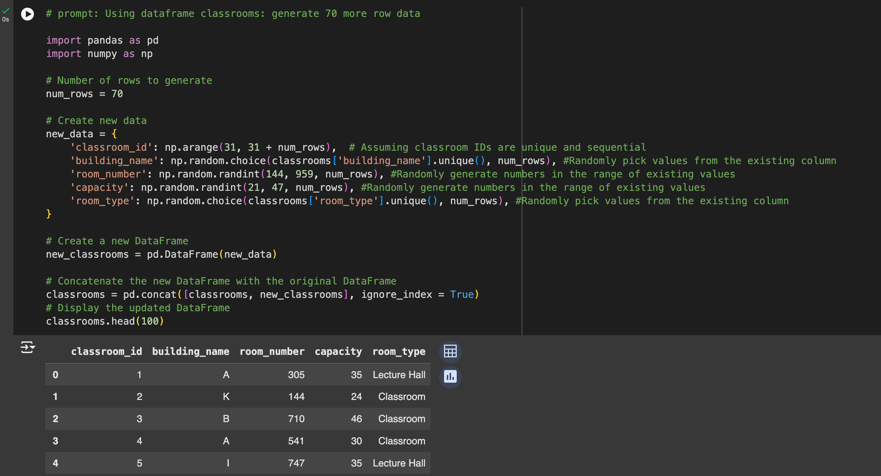
Data Augmentation
Expanded the dataset to 100 rows while maintaining statistical properties.
Ensures scalability of the algorithm.

Slide 6
Genetic Algorithm Steps
Population Initialization
Fitness Evaluation
Selection
Crossover and Mutation
Iterative process to refine the solution

Slide 7
GA Parameters
Parameter | Value | Description
Generations | 20 | Iterations to improve solutions.
Population Size | 50 | Number of schedules per generation.
Mutation Rate | 10% | Probability of random changes in a schedule.
Crossover Rate | 70% | Probability of combining two schedules.

Slide 8
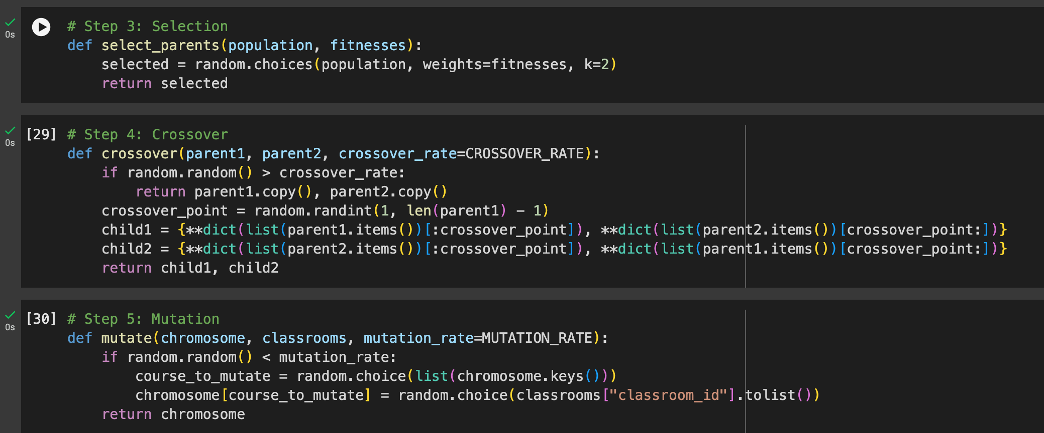
Selection Crossover Mutation
Selection: Weighted random choice of top schedules.
Crossover: Combines genetic material from two schedules.
Mutation: Introduces random changes for diversity.

Slide 9

Results
Best Fitness Score: Quantifies the quality of the best schedule.
Optimal Schedule: Maps courses to classrooms, ensuring no conflicts.

Slide 10
Applications
Exam scheduling for academic institutions.
General timetable optimization.
Resource allocation in other domains (e.g., conference room bookings).

Slide 11

Conclusion
The Genetic Algorithm successfully optimizes exam scheduling by
balancing room type compatibility and capacity requirements.
Its iterative approach, leveraging fitness-based selection and
genetic operators, ensures effective and conflict-free scheduling.
The Genetic Algorithm is a powerful tool for solving scheduling problems.
Combines efficiency, flexibility, and scalability.
Future extensions: Real-time scheduling and integration with institutional systems.

